Slide 1
SOFTWARE PROJECT MANAGEMENT
Risk and Change Management
Dr. Seemab Latif
Lecture No. 10
13th April, 2011

Slide 2
Feature Set Control
Feature Set is a group of functions.

Slide 3
Feature-Set Control
Class mistake avoidance
Early Stages: Feature Set Reduction
  Minimal Specification
  Requirements Scrubbing
  Versioned Development
Mid-Project: Feature Creep Control
  Effective change control
Late-Project: Feature cuts

Slide 4
Traditional Specifications
Drive for “traditional” specifications
      Necessity
      Downstream cost avoidance
      Full control over all aspects
    As McConnell notes:
      “But the goal is not to build exactly what you said you would at the beginning. It is to build the best possible software within the available time.”

Slide 5
Early Stages: Feature Set Reduction
Feature-set control in the early part of a project consists primarily of not putting unnecessary features into the product in the first place.
There are three basic ways to do this:
  Minimal specification
  Requirements scrubbing
  Versioned development

Slide 6
Minimal Specification
Traditionally, When you specify requirements for a project, there is usually a question about how much detail to provide in the specification. Conventional wisdom holds that more detail is better.
  The attempt to create a detailed requirements specification catches more of the requirements than a less detailed one would, which avoids the time and cost problems associated with adding requirements late in the project.
Tradition specification issues
  Wasted effort
    Too much detail
  Obsolescence -- with changing requirements, documents become obsolete
  Lack of efficacy -- details do not guarantee success
  Overly constrained design
  User assumption that costs are equal (UI ex.)

Slide 7
Minimal Specification
Minimal specification should consist of the minimal amount of information needed to meaningfully specify the product.
Benefits
    Improved morale and motivation
    Opportunistic efficiency
    Shorter requirements phase
Costs and Risks
    Omission of key requirements-- classic mistake
    Unclear or impossible goals
    Gold plating-- classic mistake
    Used for the wrong reasons-- classic mistake
      Lazy substitute for doing good requirements
Success Factors
    Used only when requirements are flexible
    Capture most important items; involve key users

Slide 8
Requirements Scrubbing
Removing a feature from the product
    Eliminates all effort: spec., design, dev., test, doc.
    The earlier the better
    Typically done during or right after Requirements
Less risky than minimal specification
Aims
    Eliminate all but absolutely necessary requirements
    Simplify all complicated requirements
    Substitute cheaper items

Slide 9
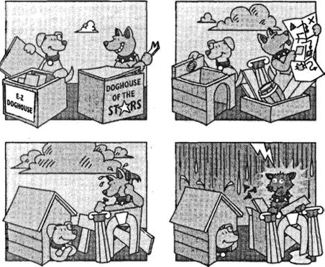
Smaller projects take less time to build.

Slide 10
Versioned Development
Eliminate them from the current version
“Let’s put it in release 1.1”
  You’re still saying “Yes”, not “No”

Slide 11
Mid-Project Feature-Creep
Avg. project has 25% change in requirements during development
Sources of change
    Marketing: want to meet customer’s check-list
    Developers: want to perfect version1 deficiencies
    Users: want more functionality or now ‘know’ what they want
They will all try to ‘insert’ these during development.

Slide 12
Change Control Board (CCB)
Best practice is to have formal change control board
Structure: representatives from each stakeholder party
  Dev., QA, Marketing, Mgmt., Customer support
Perform “change analysis”
  The change board's function is to analyse each proposed change.
  Importance, priority, cost, benefit
Triage
  Allocating scare resources
  Some will not receive treatment
  Life-critical to the project

Slide 13
Late Project: Feature Cuts
Behind schedule at the end of the project
One of the most potent schedule-reduction options is the elimination of low-priority features.
Drawback--by the time you reach the end of the project, you've probably already done the design work and part of the implementation and testing for the features that you cut.
You might even have to do some small amount of work to remove the feature.
For maximum efficiency, start with a scrubbed requirements document, design and implement the features you know will be in the product, and then add lower-priority features if you have time.

Slide 14
Homework
Top 10 Risk List for your project

